Slide 1

Apple Forecasting
Siddharth Nikam
Vaishnavi Zope
Shital Chumbalkar
Nidhi Singh
Ashwini Thite
Harshada Rawal
(Team - 06) Mentor:- Neha Gupta

Slide 2
Problem Statement
Business Objective:
Predict the apple stock market price for next 30 days.
There are Open, High, Low and Close price has been given for each day starting from 2012 to 2019 for Apple stock.
Split the last year into a test set- can you build a model to predict stock price?
Find trends in short term, or long term trends?
Understand how it is impacted from external factors or any big external events?
Forecast for next 30 days.

Slide 3
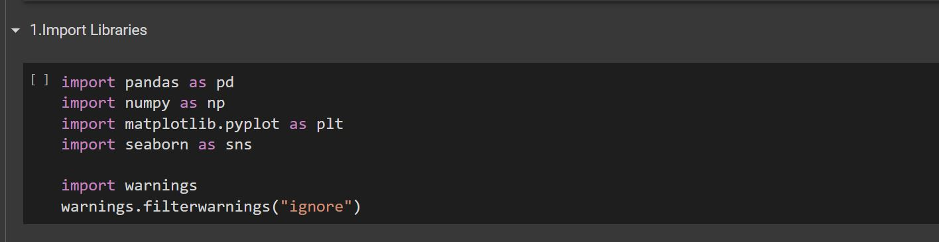
Libraries imported
Here we have imported some libraries.
Such as pandas, numpy, seaborn & matplotlib.

Slide 4
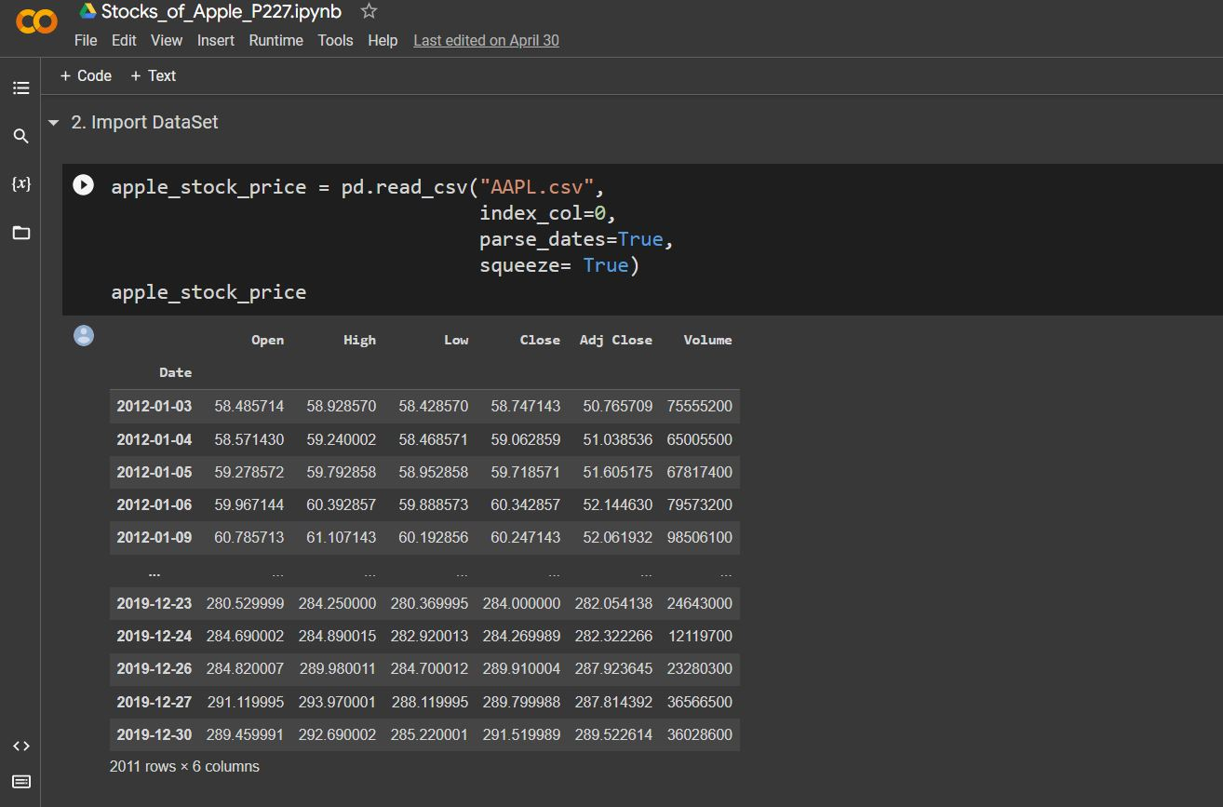
Data Loaded
Here we loaded the data or Read the Dataset
In the dataset we got to know that there are 2011 rows & 7 columns

Slide 5
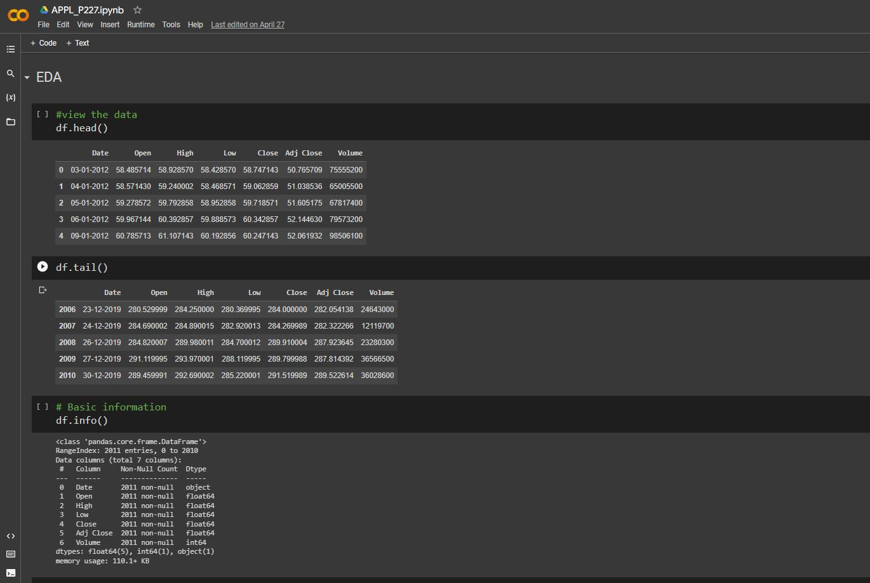
EDA (Exploratory data analysis)
Here we see the head, tail & info of the dataset
The info() method is a way to get a quick summary of the dataset's structure. It tells you the number of rows and columns in the dataset, as well as the data types of each column. This is helpful for understanding the size of the dataset and the types of data it contains.

Slide 6
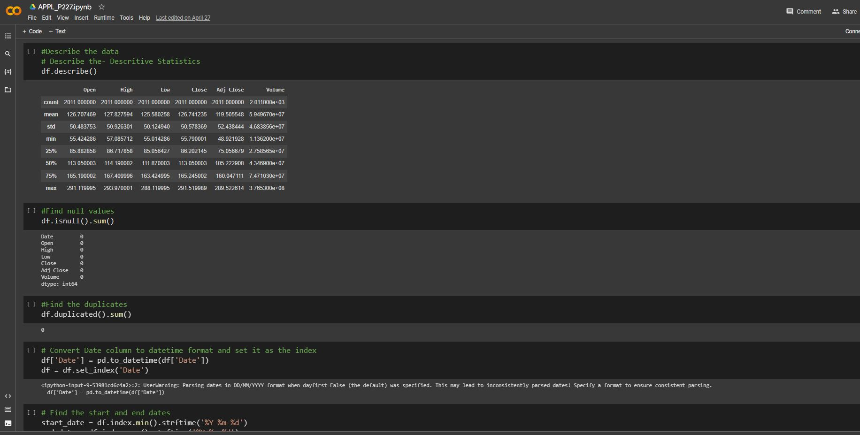
EDA (Exploratory data analysis)
On the other hand, the describe() method provides statistical information about the numerical columns in the dataset. This includes measures such as the mean, standard deviation, minimum and maximum values, as well as quartile ranges. By examining these values, you can gain insight into the central tendency, variability, and range of the dataset.

Slide 7
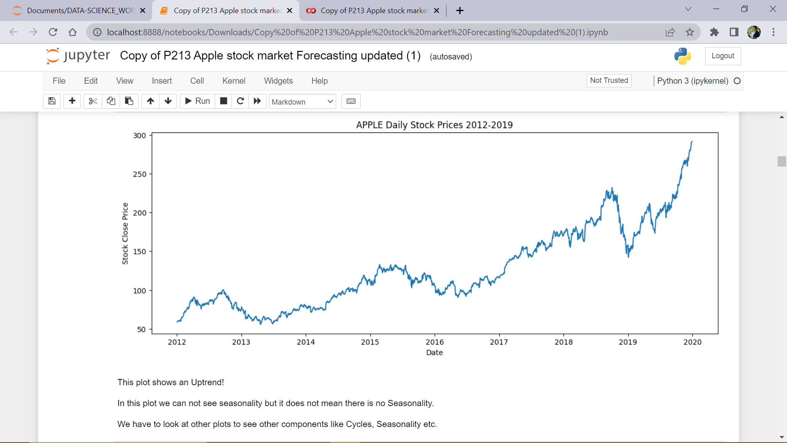
Line plot :

Slide 8
Summary
We can see that there are 2011 observations with 7 columns i.e., Date, Open, High, Low, Close, Adj.Close and Volume (of stocks traded).
We can see that there are missing values in the weekends and some other days.
Now we need to select our target column. In the problem statement it is clearly mentioned that we need to predict extra 30 days stock price, so we can not select volume column.
Adjusted close column is used for calculating Returns at any point of time. We can not use this for price prediction since adjusted close price involves dividends which are not constant over a period.
High and Low price cannot be chosen since we don't know at what time these values show up.
Compared to Open price, Close price is very important since open price has no prior data on that day so we can not see the moment of price on that day.
So, we can take "close price" as our target for forecasting

Slide 9
Summary of EDA
We used Different visualizations to get insights
Data Understanding:
Line plot said, there is an UpTrend!
Histogram said, there is a Left skewnes implies slow upward moment of stock price overtime, and suggested Long term investments.
From month wise analysis, using boxplots , shows that high risk(volatility) associated with October month over the years. And it shows occurrence of high prices in November and December months, suggesting good stock selling time for stockholders.
From Quarter wise analysis, boxplots shows occurrence of high prices in 4th Quarter, and heatmap suggesting a Seasonality of 4 quarters.
From Year wise analysis, using Boxplots, shows an UpTrend with high Stocastic nature of stock price.

Slide 10
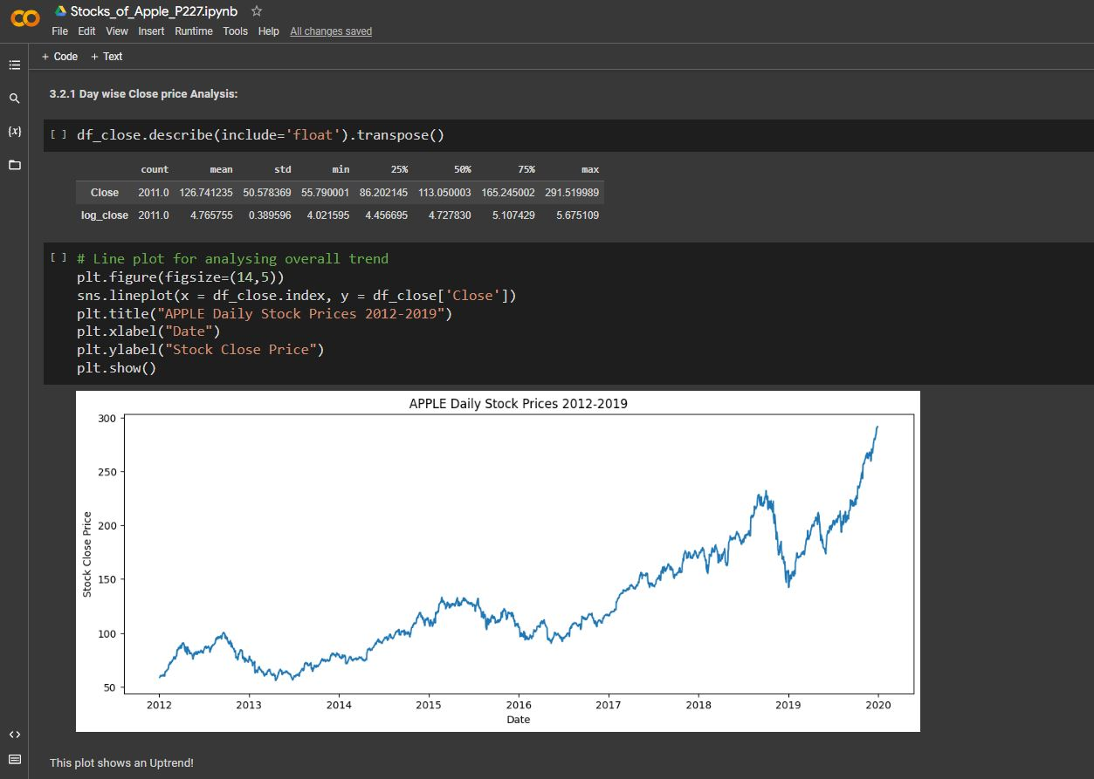
Day wise Analysis
Day-wise analysis helps us understand how a stock is performing on a daily basis.
By looking at daily closing prices, we can spot trends and patterns that may not be visible over longer time periods.
Charts and graphs can make it easier to visualize this data and identify opportunities for trading.
However, it's important to remember that day-to-day fluctuations can be influenced by a range of factors beyond the stock's overall performance.
The day-wise close price analysis can help us to determine the overall market sentiment towards a particular stock or sector.
It can also help us to identify potential entry or exit points for trades, based on the stock's historical performance.
When conducting day-wise close price analysis, it's important to consider other factors that could be impacting the stock's performance, such as news events, economic data, and market conditions.
Day-wise close price analysis is not a guaranteed method of predicting future performance, but it can provide valuable insights for traders and investors.

Slide 11
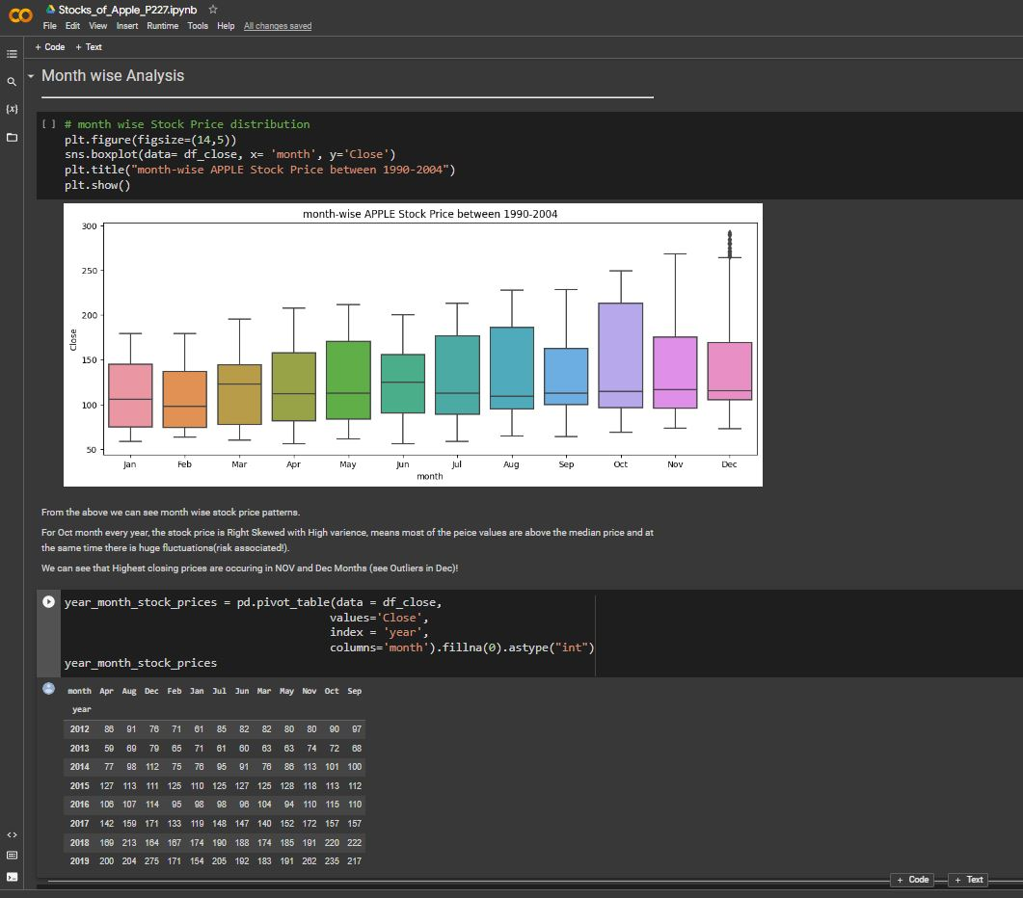
Month wise Analysis
Month-wise close price analysis is a method of studying the stock market by looking at the closing prices of a stock on a monthly basis.
By analyzing the monthly closing prices, we can identify longer-term trends and patterns in the stock's performance.
We can use charts and graphs to represent the month-wise close price data visually, which can make it easier to identify trends and patterns.
The month-wise close price analysis can help us to determine the overall market sentiment towards a particular stock or sector over a longer time period.
It can also help us to identify potential entry or exit points for trades, based on the stock's historical performance.
When conducting month-wise close price analysis, it's important to consider other factors that could be impacting the stock's performance over the longer term, such as macroeconomic factors, industry trends, and company-specific news

Slide 12
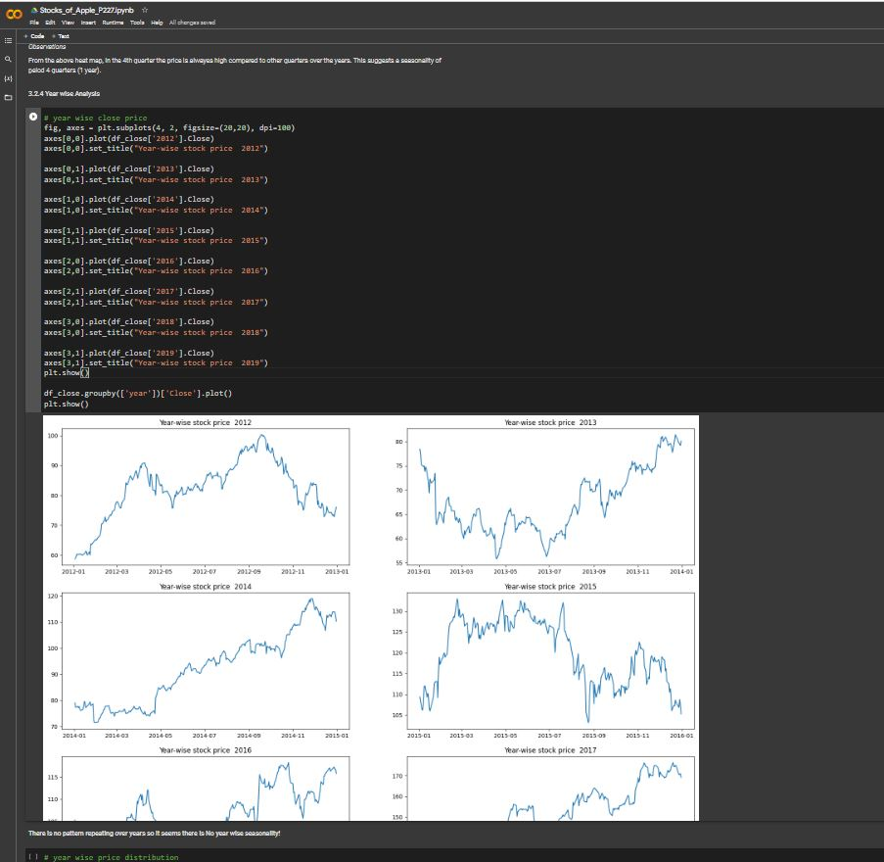
Year wise Analysis
Year-wise close price analysis is a method of studying the stock market by looking at the closing prices of a stock on an annual basis.
By analyzing the annual closing prices, we can identify longer-term trends and patterns in the stock's performance over multiple years.
We can use charts and graphs to represent the year-wise close price data visually, which can make it easier to identify trends and patterns.
The year-wise close price analysis can help us to determine the overall market sentiment towards a particular stock or sector over a longer time period.
It can also help us to identify potential entry or exit points for trades, based on the stock's historical performance over multiple years.
When conducting year-wise close price analysis, it's important to consider other factors that could be impacting the stock's performance over the longer term, such as global economic trends, geopolitical events, and industry-specific factors.
Year-wise close price analysis is not a guaranteed method of predicting future performance, but it can provide valuable insights for traders and investors over a long-term horizon.

Slide 13
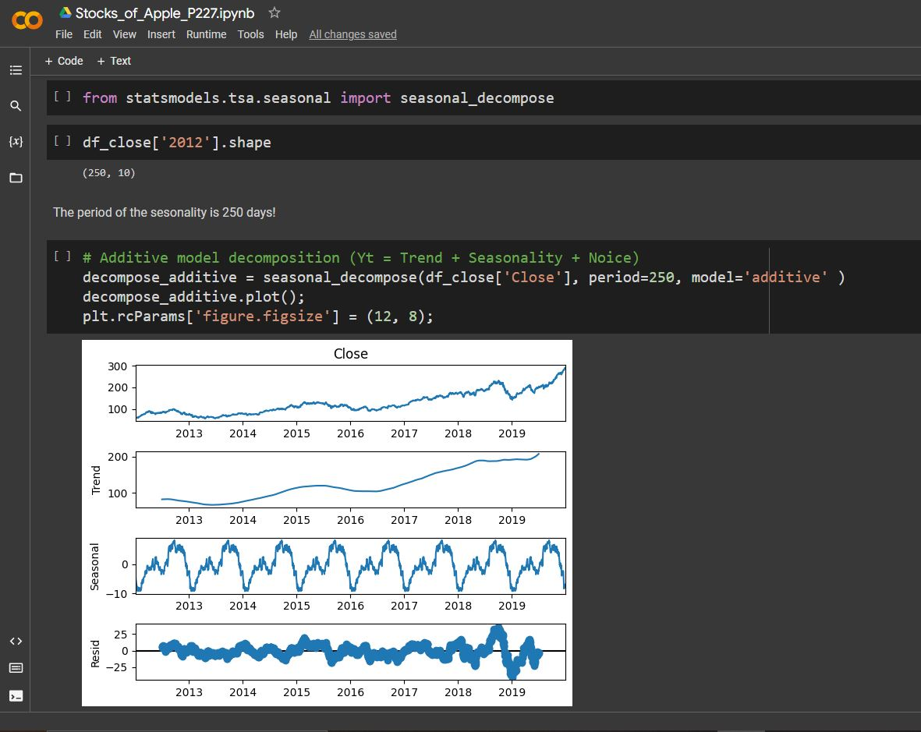
Seasonality
Seasonality analysis is like studying a stock's wardrobe - we look at how it performs in different seasons of the year.
By analyzing seasonal trends and patterns, we can spot opportunities for trading and investment that might not be visible over longer timeframes.
This analysis helps us identify when a stock tends to perform well or poorly at different times of the year.
We can use charts and graphs to visualize these seasonal trends and patterns, making it easier to spot trading opportunities.

Slide 14
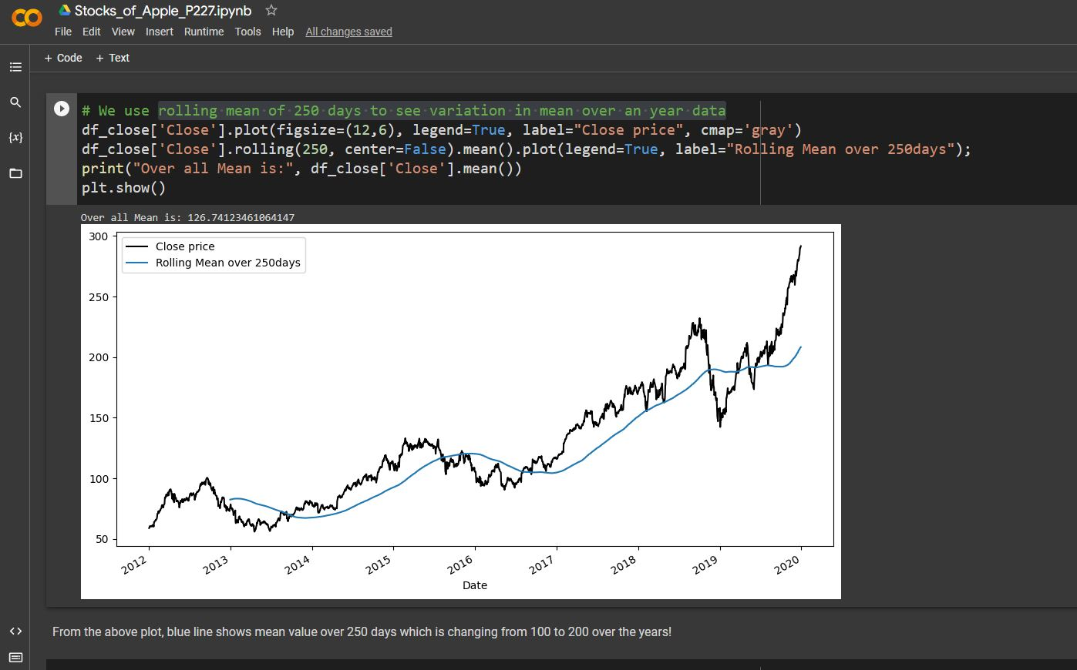
rolling mean of 250 days to see variation in mean over an year data
Rolling mean analysis is a method of studying the stock market by looking at the average price of a stock over a rolling time period.
By using a rolling mean of 250 days, we can study the average price of a stock over a year's data, and see how it changes over time.
This analysis can help us identify long-term trends in a stock's performance, and how they relate to the broader market.
We can use charts and graphs to visualize the rolling mean over time, and see how it changes as new data is added.
This analysis can be useful for identifying potential entry or exit points for trades, based on changes in the stock's average price over time.
It's important to consider other factors that may be impacting the stock's performance beyond the rolling mean, such as news events or market conditions.
Rolling mean analysis is not a guaranteed method of predicting future performance, but it can provide valuable insights for traders and investors.

Slide 15
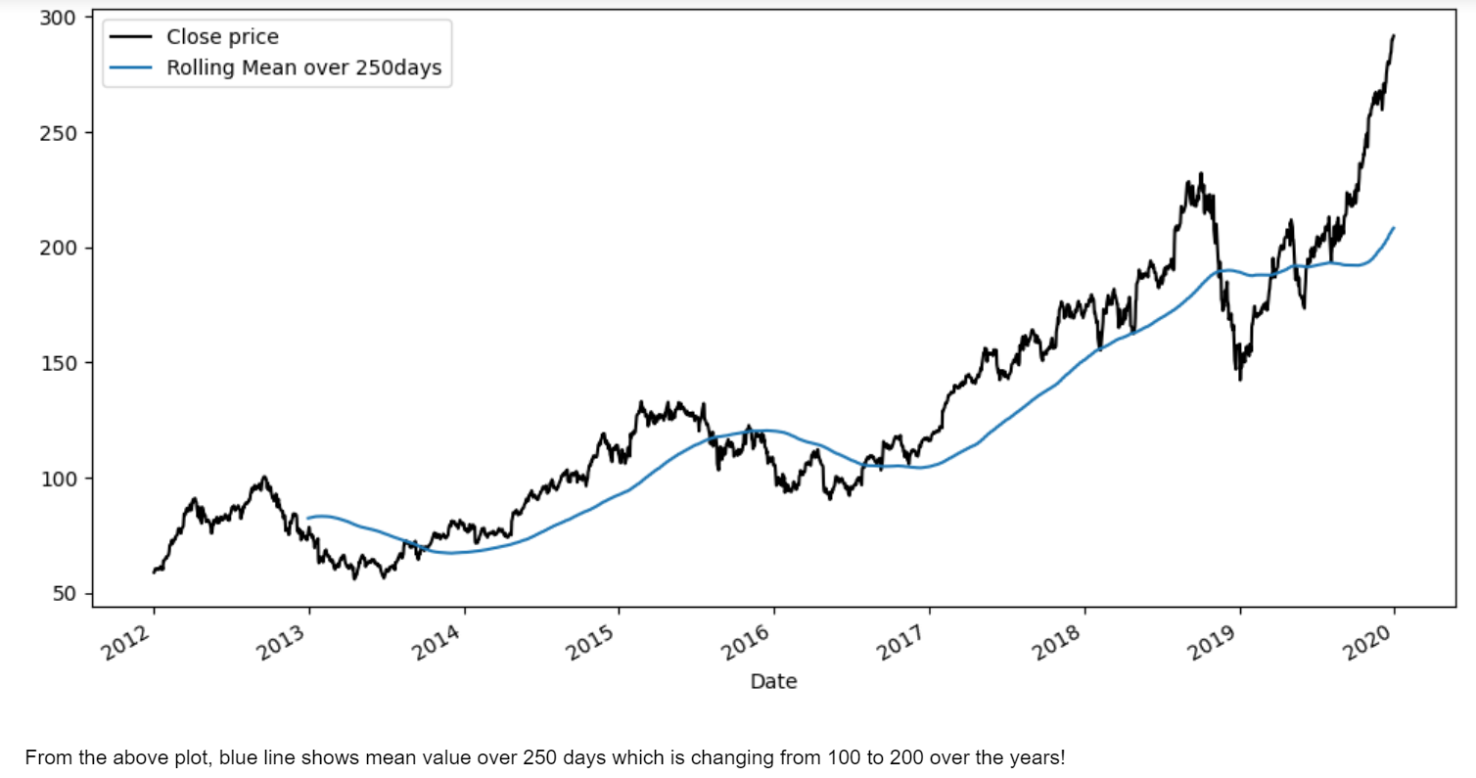
Rolling mean over 250 days

Slide 16
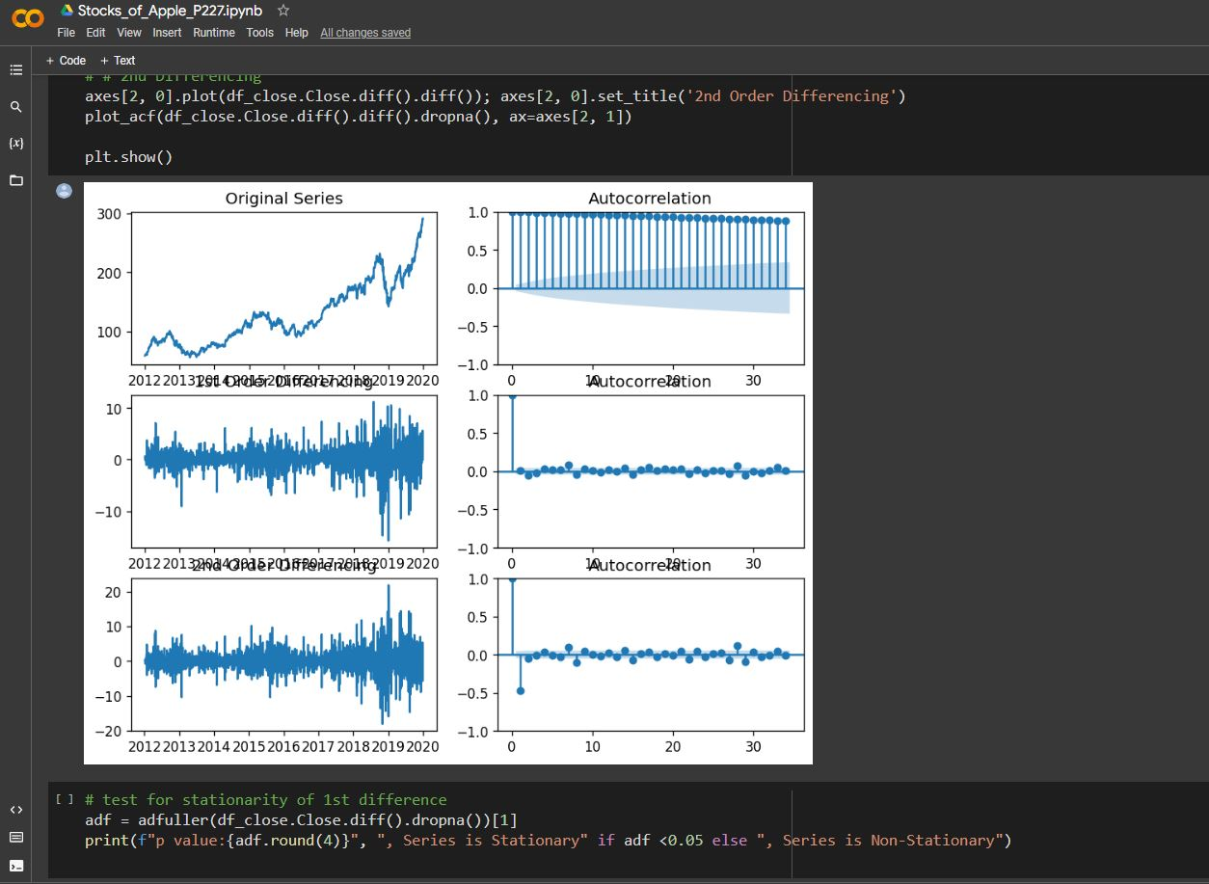
Checking if data is Stationary or not
Non-stationary data is like a wild animal - it's hard to predict its behavior. Stationary data, on the other hand, is like a well-trained pet - it behaves consistently over time.
To make non-stationary data behave more like stationary data, we can use statistical techniques like differencing, logarithmic transformations, or seasonal adjustments.
By converting non-stationary data to stationary data, we can better understand the long-term trends and patterns that are less susceptible to short-term fluctuations.
We can use charts and graphs to visualize the stationary data and see how it relates to other market factors.
This analysis can help us identify potential entry or exit points for trades, based on consistent patterns in the data.
It's important to consider other factors that may be impacting the stock's performance beyond stationary data, such as news events or market conditions.
Converting non-stationary data to stationary data is not a guaranteed method of predicting future performance, but it can provide valuable insights for traders and investors.

Slide 17
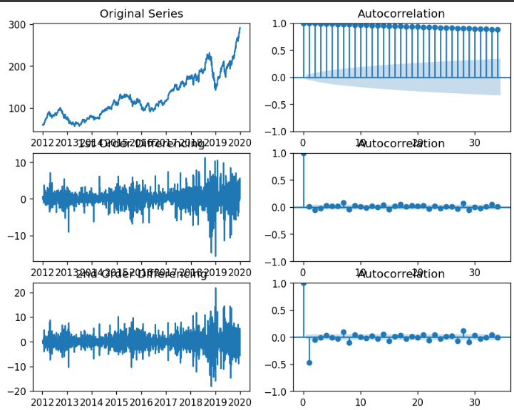
ACF plot for 1st differenced data

Slide 18
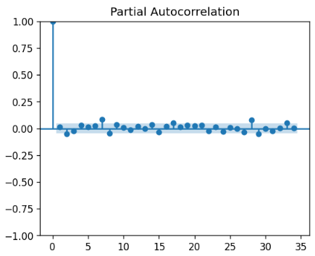
PACF plot for 1st differenced data

Slide 19
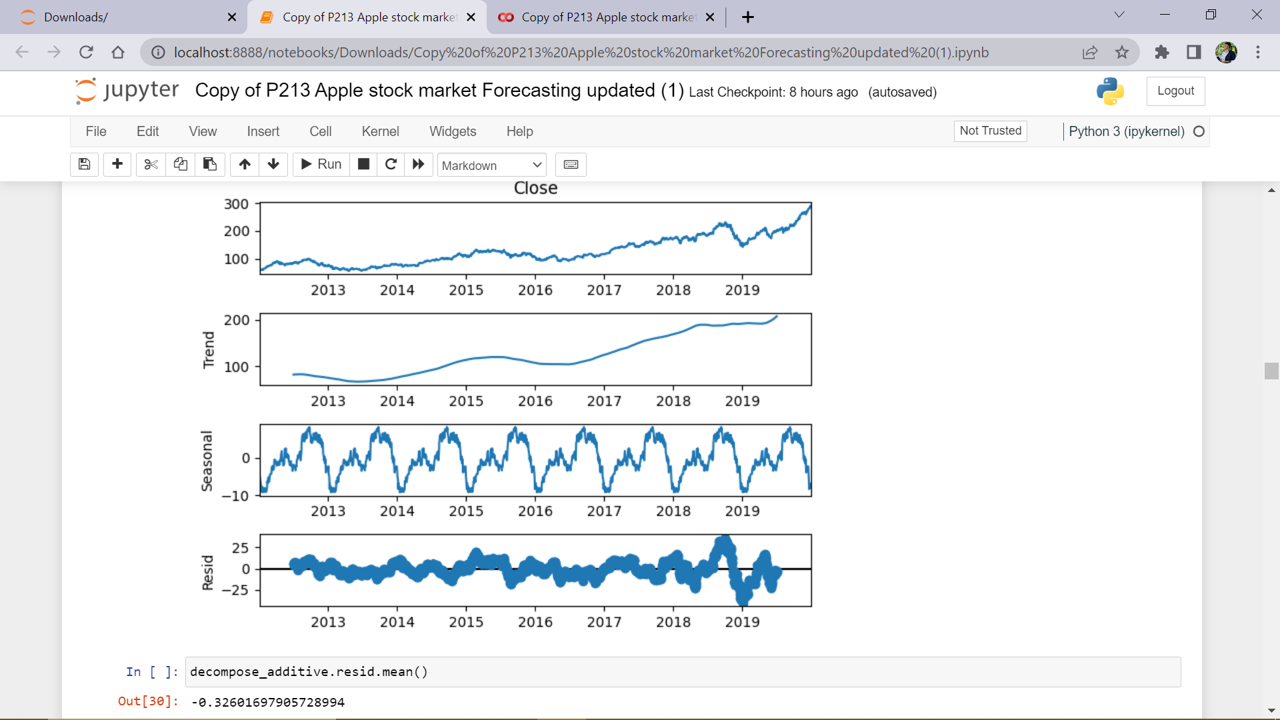
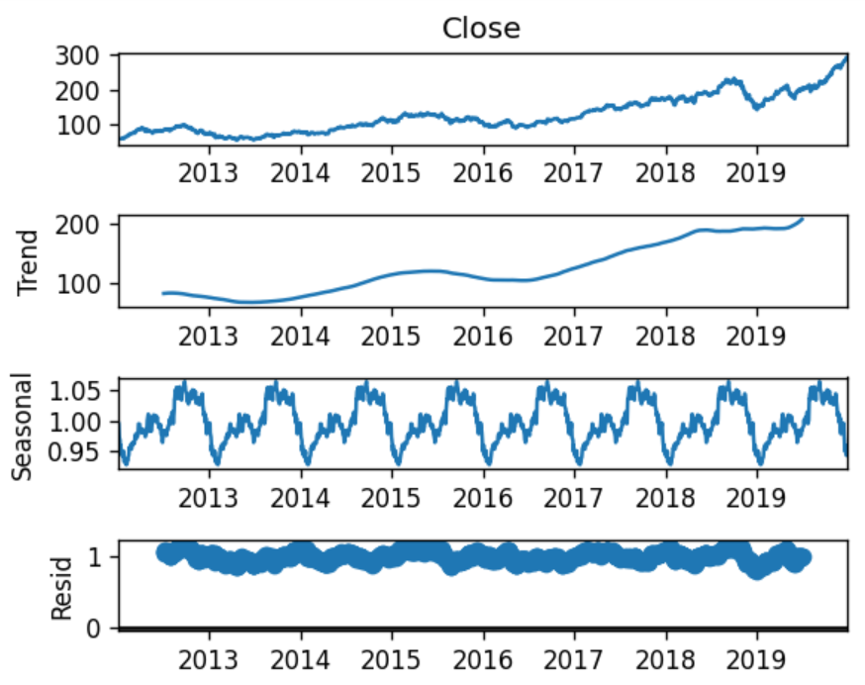
Decomposing Time-Series using Seasonal__Decompose
Additive Model
Multiplicative Model

Slide 20
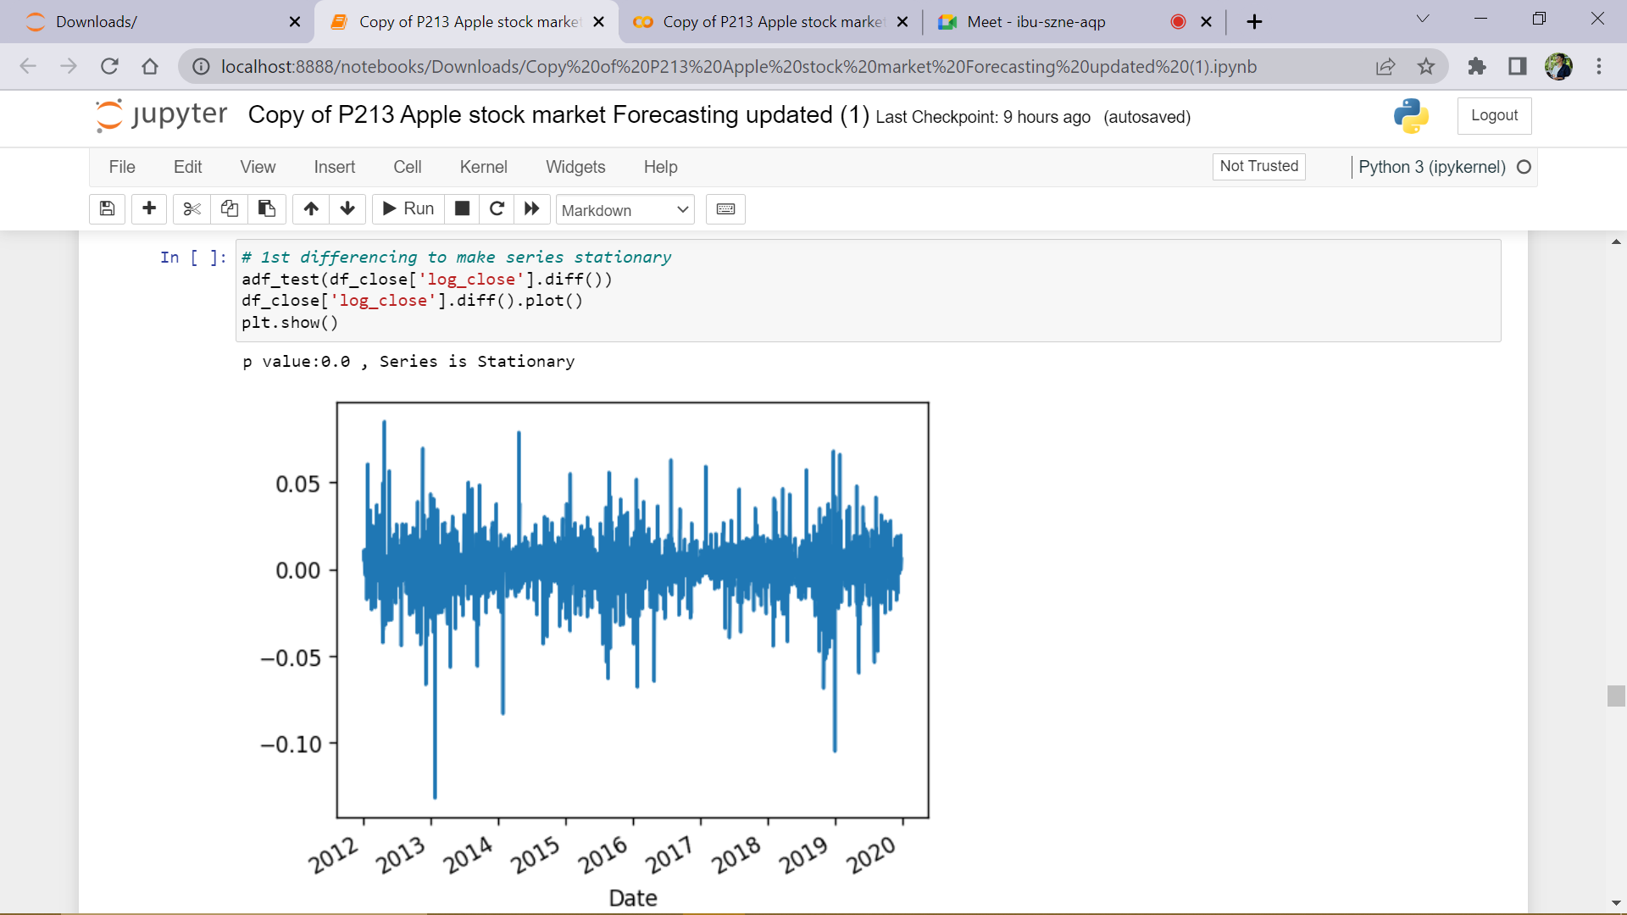
1st ORDER DIFFERENCING

Slide 21
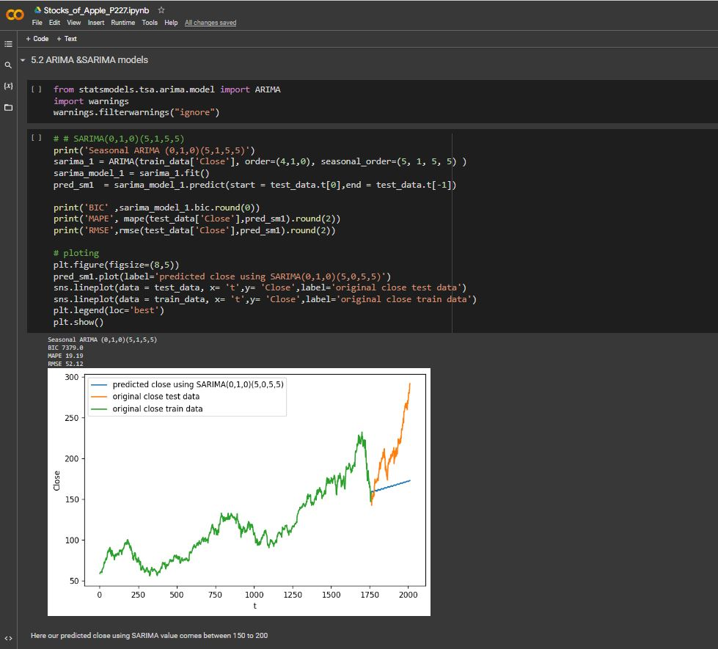
Arima Model
The ARIMA model output indicates a Seasonal ARIMA (0,1,0)(5,1,5,5) model is appropriate for the given dataset.
The (0,1,0)(5,1,5,5) notation specifies the number of autoregressive, differencing, and moving average terms in the model, as well as the number of seasonal autoregressive, differencing, and moving average terms with a seasonal period of 5.
The BIC value of 7379.0 suggests the model fits the data well and has a good balance of complexity and accuracy.
The MAPE value of 19.19% indicates that the average error of the model is around 19.19% of the actual value, while the RMSE value of 52.12 shows the average deviation of the model from the actual values is 52.12.
These results suggest that the model is a good fit for the data and can be used to analyze trends and make predictions based on the seasonality component of the data.
It is important to note that ARIMA models are not perfect predictors and should be used in conjunction with other methods and analysis.

Slide 22
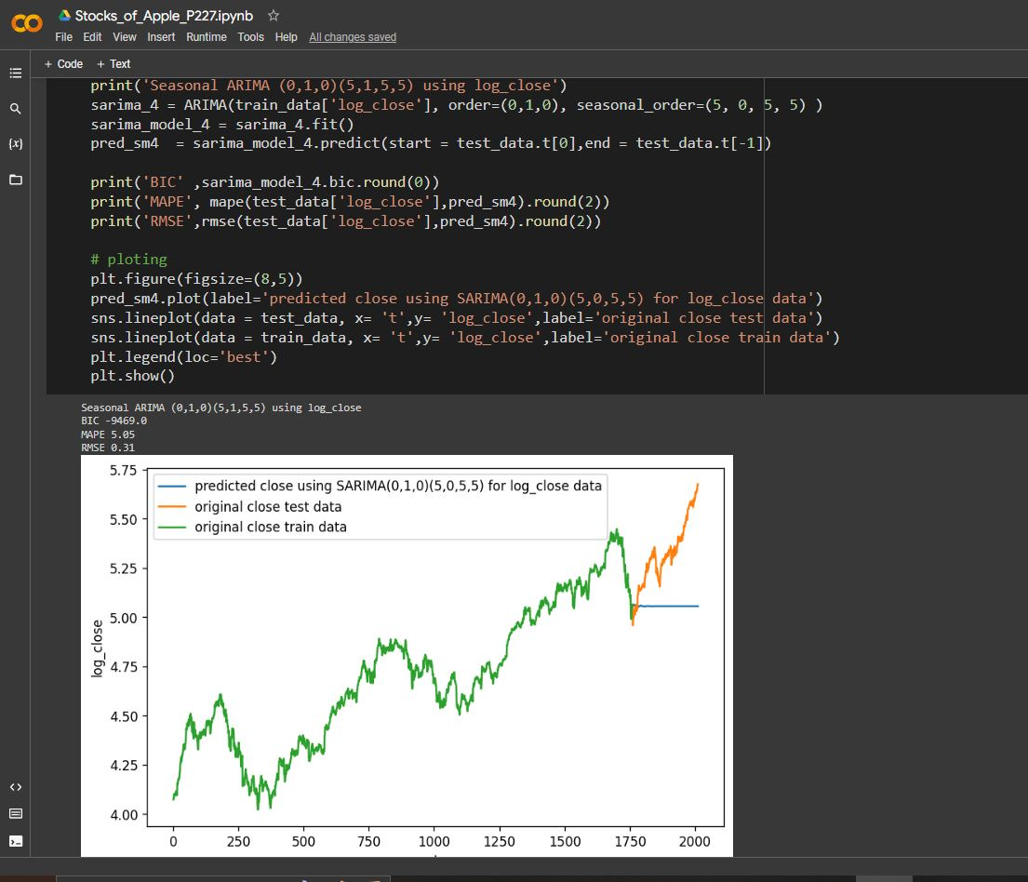
SArima Model
The SARIMA model output indicates a Seasonal ARIMA (0,1,0)(5,1,5,5) model is appropriate for the given dataset after applying a logarithmic transformation to the close price data.
The (0,1,0)(5,1,5,5) notation specifies the number of autoregressive, differencing, and moving average terms in the model, as well as the number of seasonal autoregressive, differencing, and moving average terms with a seasonal period of 5.
The BIC value of -9469.0 suggests that the model fits the data well and has a good balance of complexity and accuracy.
The MAPE value of 5.05% indicates that the average error of the model is around 5.05% of the actual value, while the RMSE value of 0.31 shows the average deviation of the model from the actual values is 0.31.
These results suggest that the model is a good fit for the data and can be used to analyze trends and make predictions based on the seasonality component of the data after applying a logarithmic transformation to the close price data.
The logarithmic transformation helps to stabilize the variance of the data and makes it more stationary, which can improve the accuracy of the model.
It is important to note that SARIMA models are not perfect predictors and should be used in conjunction with other methods and analysis.

Slide 23
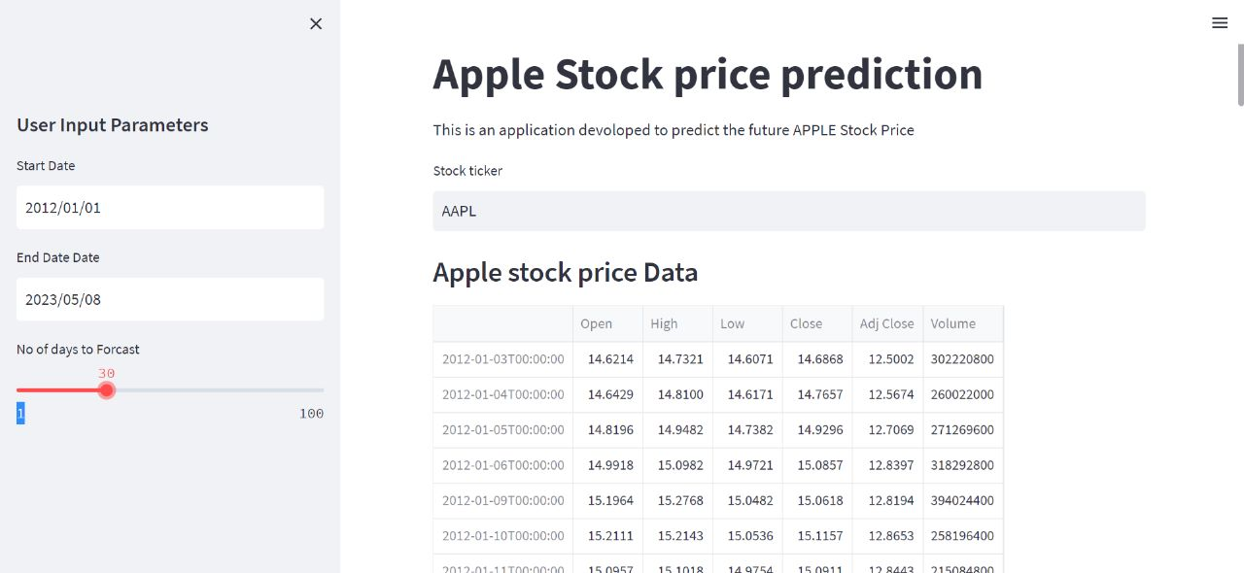
Model DEployment
Here is the stocks price of apple, as we predicted for next 30 days

Slide 24
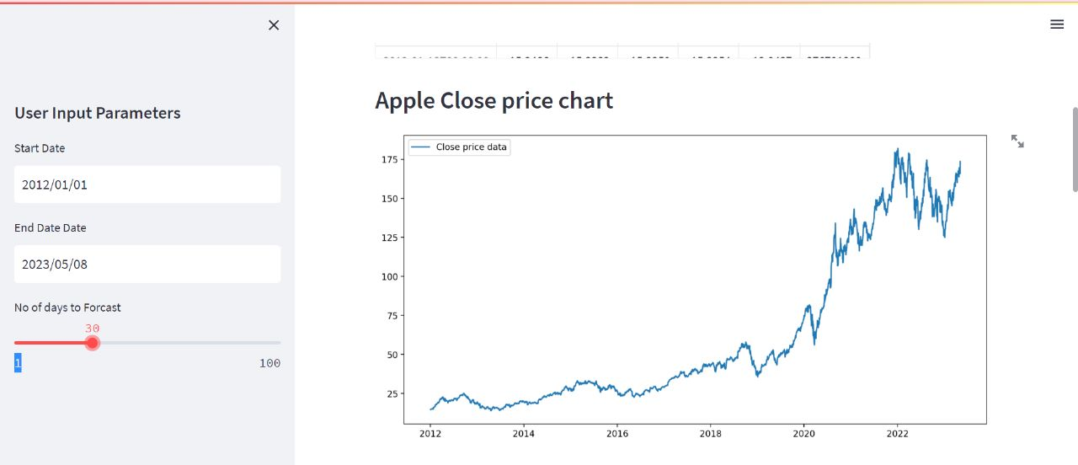
Model DEployment
Here is the Close price chart of apple stock for 30 days, the data is taken from 2012 to 2023(Present) for better predictions

Slide 25
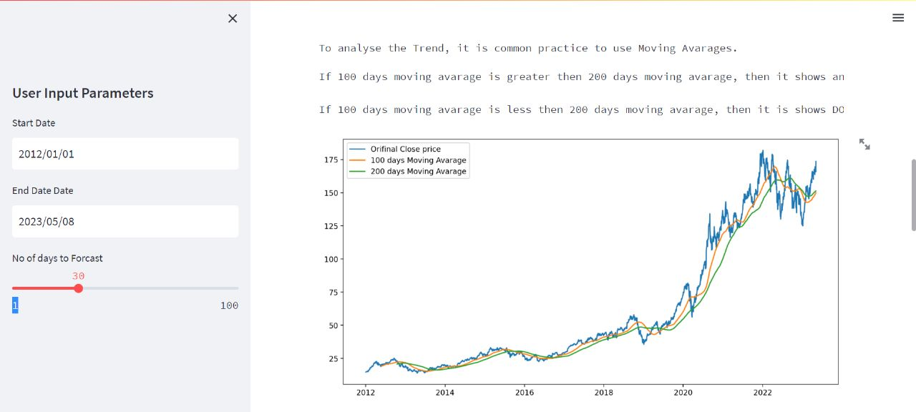
Model DEployment
Here is the 100 & 200 moving average of apple stock for 30 days, the data is taken from 2012 to 2023(Present) for better predictions

Slide 26
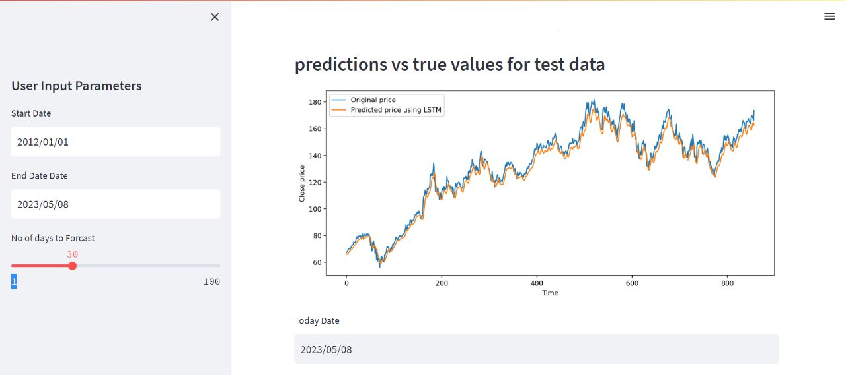
Model DEployment
Here is the predictions v/s True values for the test data, the data is taken from 2012 to 2023(Present) for better predictions

Slide 27
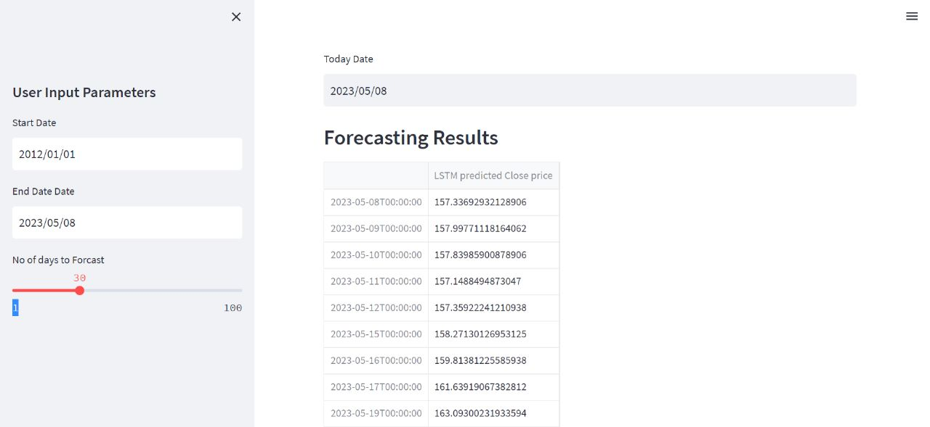
Model DEployment
Here is the Forecasting Results of the Apple Stocks

Slide 28
Thank You
From:- group-06

